Slide 1
Dungeons and Dragons Character Manager
By:
Benjamin Costantino, Benjamin Hobbs, Thomas Mcfarling,
Austin Oldham, Christopher Sumruld, Zachary Vanloon, Braxton Vogel

Slide 2
Introduction
Database‑driven application for creating and managing D&D 5e characters
Stores structured data: attributes, class, subclass, background, features, spells, weapons, equipment
Users build complete, rule‑compliant character profiles through database‑linked selections
Provides quick access to key character details during gameplay
Improves organization and consistency compared to traditional paper character sheets

Slide 3
User Requirements
Player Users
Dungeon Masters
Create, customize, and manage D&D characters
Enter core attributes: name, level, ability scores, HP
Select primary class, species, and background (many‑to‑one relationships)
Add feats, weapons, and spells (many‑to‑many relationships)
View a complete, rule‑compliant character sheet
View all characters stored in the system
Open detailed character sheets for gameplay reference
Verify spell legality and class‑specific abilities

Slide 4
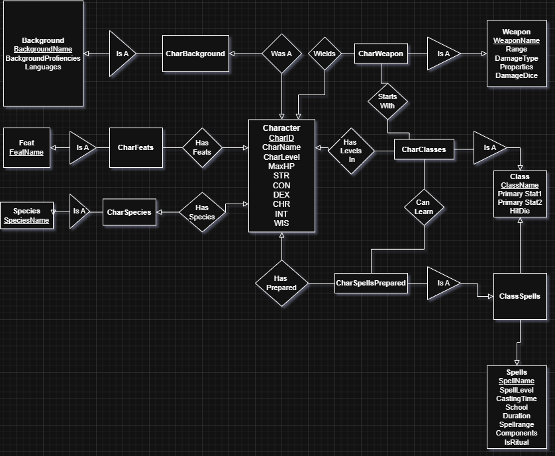
Entity Relationship Diagram

Slide 5
Relational Schema
Character (CharID, CharName, CharLevel, STR, CON, DEX, WIS, INT, CHA, MaxHP)
Classes (ClassName, Primary Stat1, Primary Stat 2, HitDie)
CharacterClasses (CharID, ClassName) #CharId is FK references Character (CharID), ClassName is FK references Classes (ClassName)
Spells (SpellName, SpellLevel, CastingTime, School, Duration, Spellrange, Components, IsRitual)
ClassSpells (ClassName, SpellName) #ClassName is FK references Classes (ClassName), SpellName is FK references Spells (SpellName)
CharacterSpellsPrepared (CharID, SpellName) #CharId is FK references Character (CharID), SpellName is FK references Spells (SpellName)
Weapons ( WeaponName, Range, DamageType, Properties, DamageDice)
CharacterWeapons (CharID, WeaponName) #CharId is FK references Character (CharID), WeaponName is FK references Weapons (WeaponName)
Backgrounds (BackgroundName, BackgroundProficiencies, Languages)
CharacterBackground (CharID, BackgroundName) #CharId is FK references Character (CharID), BackgroundName is FK references Backgrounds (BackgroundName)
Feats (FeatName)
CharacterFeats (CharID, FeatName) #CharId is FK references Character (CharID), FeatName is FK references Feats (FeatName)
Species (SpeciesName, CreatureType, Speed, SpeciesProficiencies)
CharacterSpecies (CharID, SpeciesName) #CharId is FK references Character (harID), SpeciesName is FK references Species (SpeciesName)

Slide 6
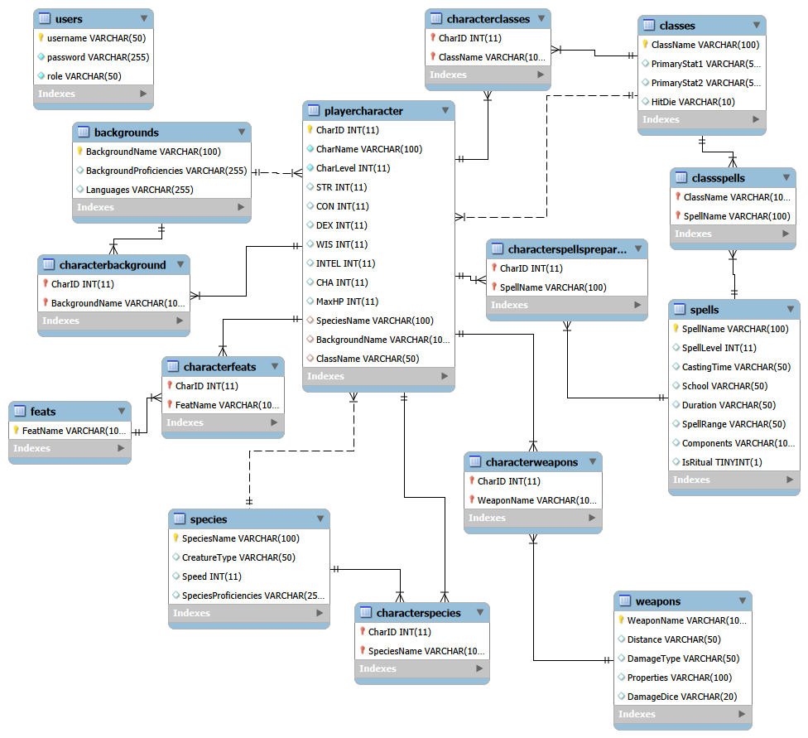
Generated Database Diagram

Slide 7
SQL Implementation
Test Case 1: Verify a Character’s class is stored properly.
Business requirement: A Player character must have exactly one class (Many-to-one)
Test Query:
SELECT CharID, CharName, ClassName
FROM PlayerCharacter
Outcome:
CharID | CharName | ClassName
15 | Test1 | Cleric
16 | Bollinatallin | Druid

Slide 8
Database Application
MAMP powered the MySQL server.
MySQL Workbench manages the database.
Spring Boot Framework to build the web application, handle routing, dependency injection, and simplify server-side development.
Java Development Kit (JDK 17/21) provides the java compiler and runtime environment.
Maven Build tool manages project dependencies, compiles the application, and packages it into a runnable JAR file.
IntelliJ IDEA to develop, run and debug the Spring Boot application with integrated Maven
Thymeleaf Template Engine used to generate dynamic HTML pages for character creation, listing, and viewing within the Spring Boot farmwork.
GitHub used for hosting the full project repository for submission, collaboration, and backup.

Slide 9
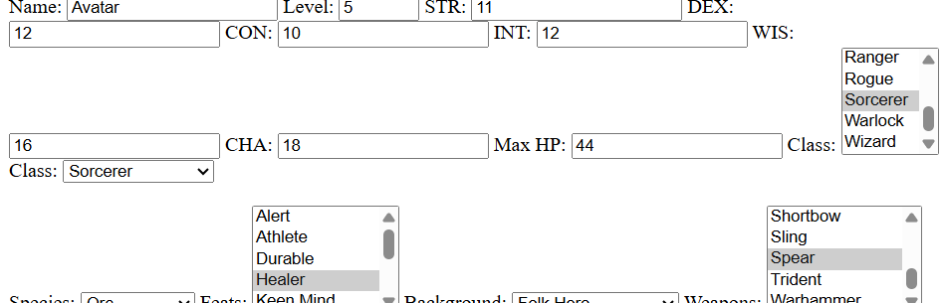
Application Test
Objective: Ensure the system can create a new character and store all required fields.
Scenario:
User opens the “Create Character” form.
Enters name, level, ability scores, species, background, class, feats, and weapons.
Clicks Create.

Slide 10
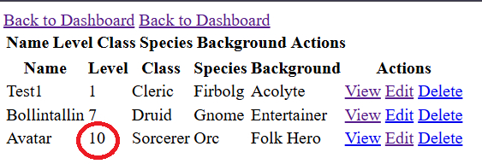
Application Test
Objective: Verify that updates made through the UI correctly modify the database.
Scenario:
User selects a character from the list.
Clicks Edit.
Changes level, stats, or class.
Clicks Save Changes.

Slide 11
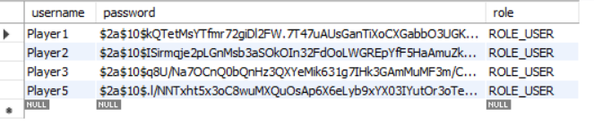
Security Evaluations
Test Case 2 — Verify Passwords Are Not Stored in Plaintext
Scenario: Query database to see users and passwords.

Slide 12

Future Work
Add full user account system: registration, password recovery, and role‑based dashboards
Redesign and polish the character sheet to more closely match official Wizards of the Coast layouts
Expand functionality with campaign management, inventory tracking, and printable/exportable character sheets
Enhance long‑term deployment by integrating containerization, cloud database hosting, and CI/CD pipelines

Slide 13
Conclusion
Designed and implemented a full‑stack D&D character creation system using Spring Boot, MySQL, and Thymeleaf
Gained hands‑on experience with database modeling, entity relationships, backend–frontend integration, and real‑world debugging
If starting over, we would plan the architecture earlier—especially authentication, UI structure, and database normalization
We would also introduce automated testing and containerized deployment sooner to improve scalability and maintainability

